Slide 1


MEP/MEP event
25-November-2025
Information about the MEP

Slide 2
Year 1 Elements
Core courses
  Theory (26 EC)
  Skills
    Project development courses (10 EC)
    Seminars (2 EC)
Electives (22 EC)
Notes:
Can do these two things in any order.

Slide 3
Year 2 Elements
Broadening Research project (15 ECs)
  Internship/Academic Research Projects (new course codes)
  Interdisciplinary projects (several options)
Master End Project
  MEP Preparation/Kick off (3 ECs) (self-study)
  MEP NB5942 (42 ECs)
Notes:
Can do these two things in any order.

Slide 4
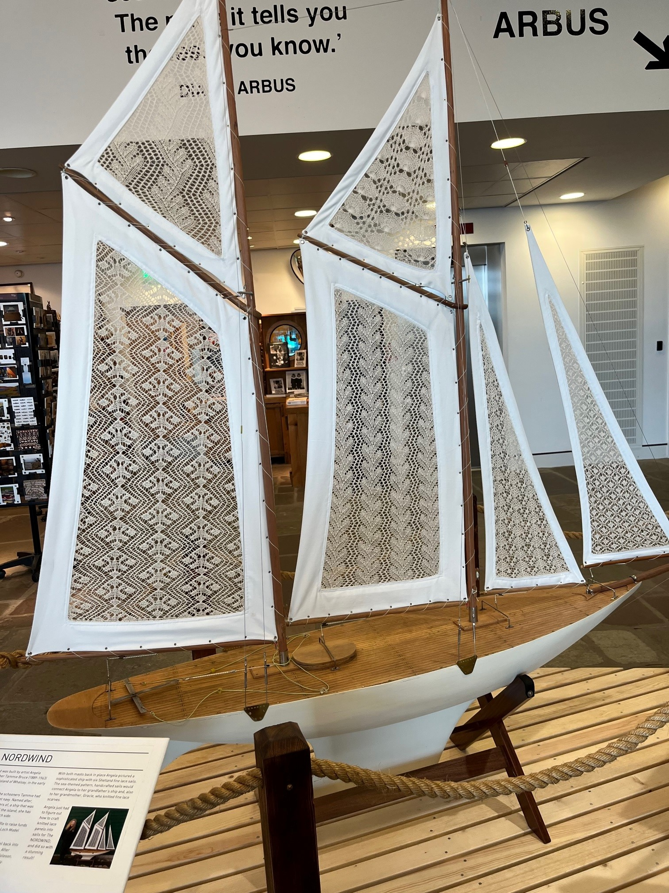
What is a Master’s End Project (MEP)?
What is it?
How long is it?
What does it include?
Notes:
Individual research project (42 ECT) in research group at TU Delft, Erasmus MC or comparable research lab elsewhere
Takes approx. 28 weeks (slightly less than 3 quarters)
Includes writing a thesis, presentation and defence
Requires proper planning
See also the study guide

Slide 5
Steps of a MEP
Enrol in Brightspace Thesis End Project
Find a supervisor and project
Do the Project Development Courses
Do the MEP-Prep course
Do the research
Write the report
Defend it

Slide 6

Enrol in Brightspace
GreenList
Research Projects Handbook
MyCase
Grading Scheme

Slide 7
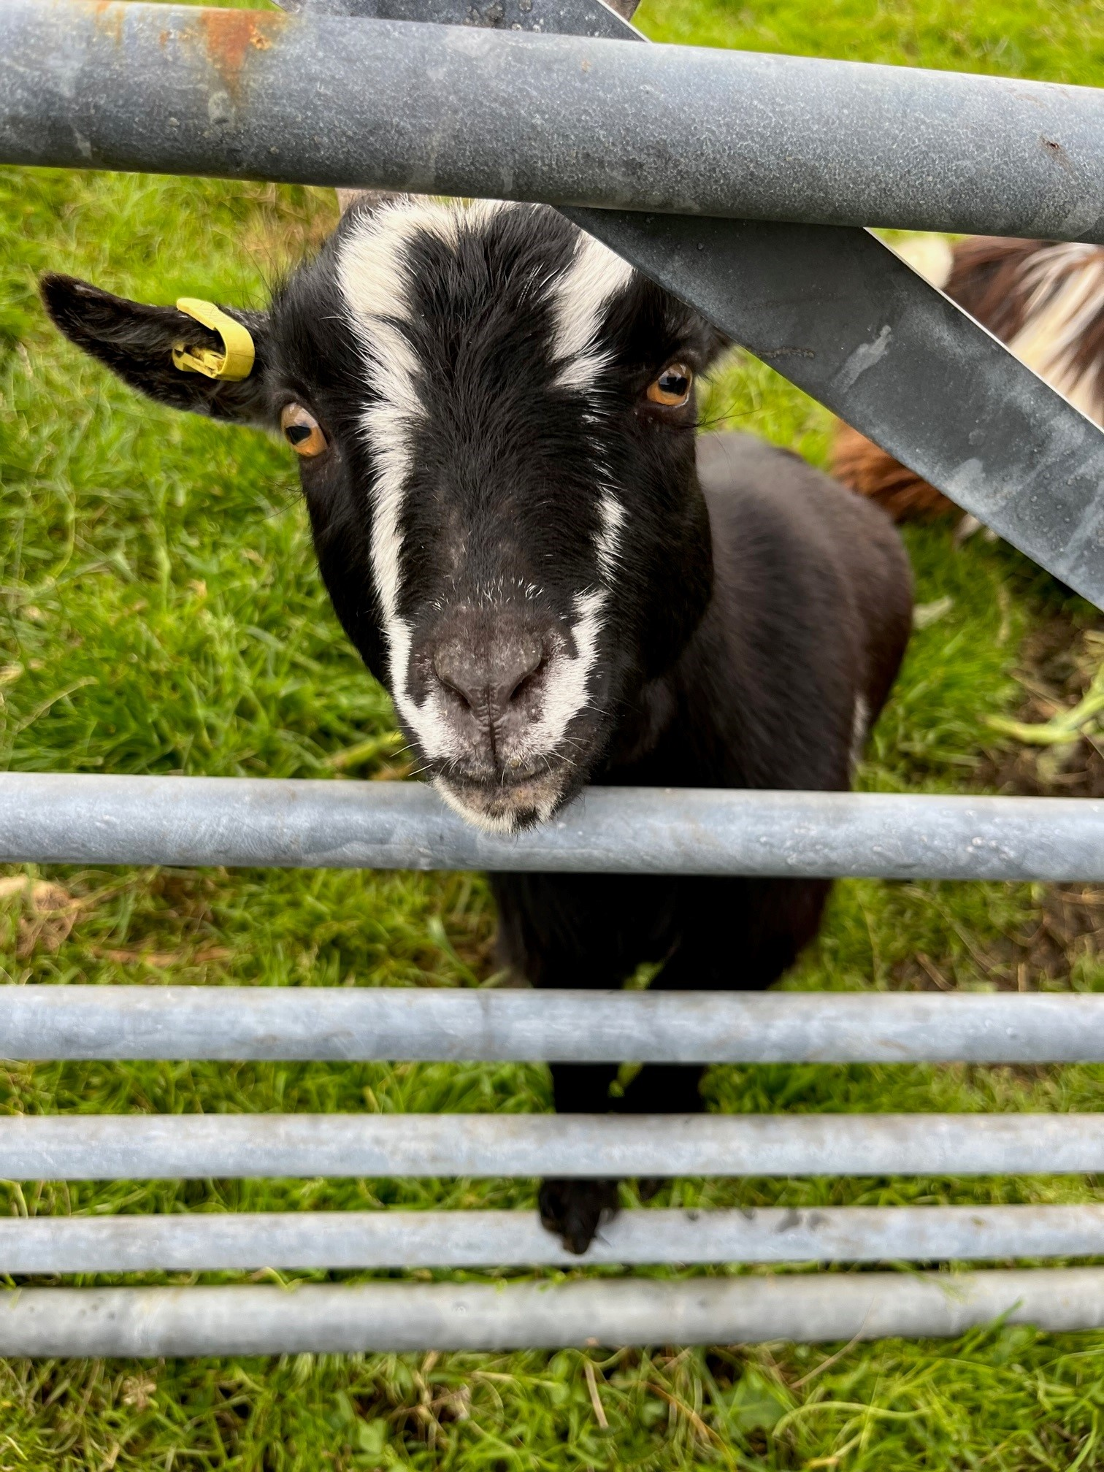
How do you find a supervisor?
GreenList
Seminars
Read articles
Network
BEP/MEP Database
Notes:
Come up with a broad plan: research field, type of project, type of supervision, start & duration
Use the GreenList to identify potential supervisors
Attend seminars and talks by interesting supervisors
Read articles from research groups you think are interesting
Ask friends, teachers, mentors, BEP supervisor for input
Look in the BEP/MEP Database
Go to the MEP event (you’re here)

Slide 8
Meet with Potential Supervisors
Talk to more than one:
Bring your study plan
Ask all your questions
Indicate clearly what you want
Consider your options, focus not only on content MEP
Pick a supervisor who you can talk to
Notes:
Consider how hard it was to arrange a time to meet with them.

Slide 9
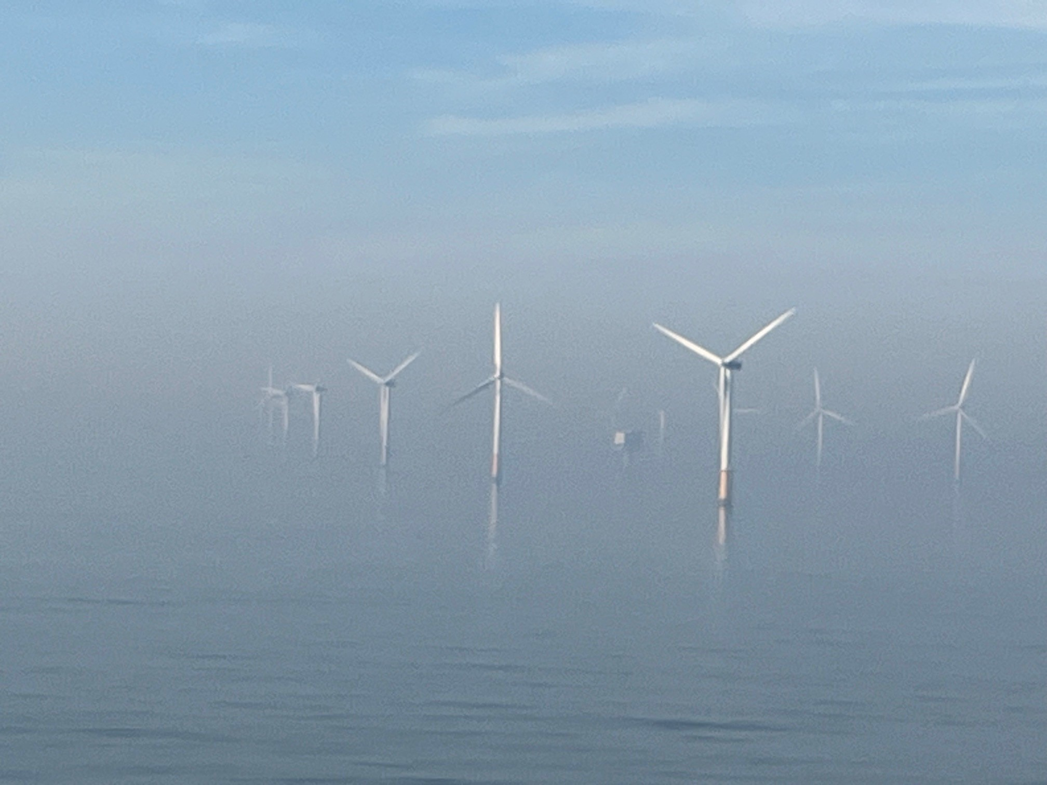
Considerations
You should ask about:
Research group work environment
Communication with supervisor
Average time to completion
Outcomes—where do graduates of the lab go
Notes:
You want a research group that works well together, is supportive of each other, and has a level of social engagement that you’re comfortable with. Is all work done in the lab, will you have a spot to work?
You want a supervisor who is eager to communicate with you and who doesn’t intimidate you.
Some supervisors are super strict about getting things done on time, some are more flexible, consider what works well for you.
Especially if you want to go into a PhD programme, seeing where students from the lab have ended up can give a good indication of what will be supported for you.

Slide 10
Supervision
Must be on the GreenList: this person is officially responsible for your MEP and the assessment.
Guidance on your MEP is almost always done by daily supervisor: mostly PhD student or Postdoc.
Picking a supervisor who is a good match for you may be the most important part of your MEP.
Make sure your supervisor(s) is someone you can talk to—you’ll need to talk a lot.

Slide 11
Requirements for Starting
Completed 35 ECTS from the NB MSc
Passed any remaining bridging/homologation courses
Have a study plan for remainder of courses
Completed Project Development Courses (NB4510 and NB4520)
MEP supervisor may not be same as for any other MSc research project or internship.

Slide 12
MyCase Phases
Kick-Off—MEP-PREP Are you ready to start?
Midterm—Are you on track?
GreenLight A—Is it ready to finalize?
GreenLight B—Assessment committee
Finalisation—Are you ready to defend it?
Notes:
TU Delft wide system for tracking MyCase.
Kick-Off makes sure that everyone does sufficient project planning
For Midterm and Greenlight you and your supervisor define what you’ll review in at these points.

Slide 13
NB5903 MEP-PREP 3 EC
Required elements:
Updated/new project plan
  Supervision plan, data management
Clear timeline
All details in Guidelines
Notes:
This is about thinking through what you plan/want to do and discussing it with your supervisor. This is not a contract that you will do exactly that.

Slide 14
A good start
Have agreement on work environment—lab space, resources, participation in research group activities
Have clear communication channels and expectations between you and daily supervisor and responsible supervisor—when, where, how
Make a plan—your plan, deadlines and structures you need. Have agreement on plan with supervisor.

Slide 15
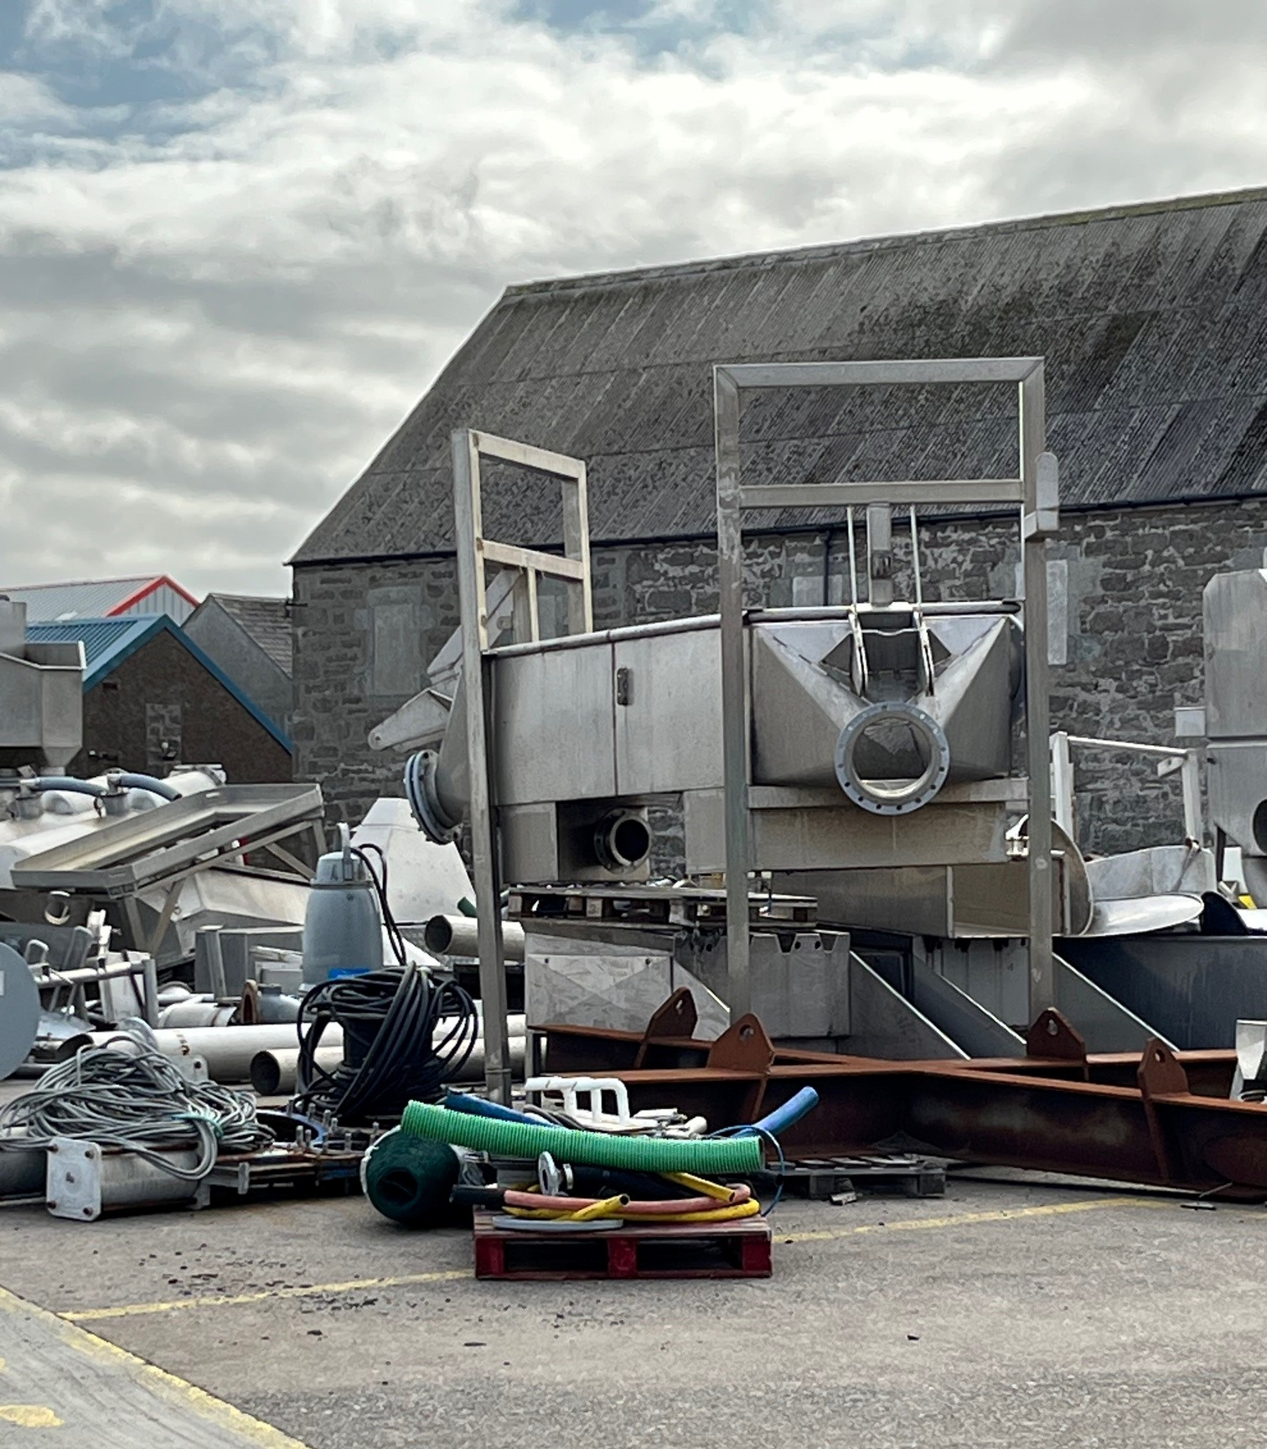
Work on it
Typically it takes 7-8 months.
You can do it part time or full time depending on other coursework.
Update your plan with your supervisor.
Ask us when you have questions or problems.

Slide 16
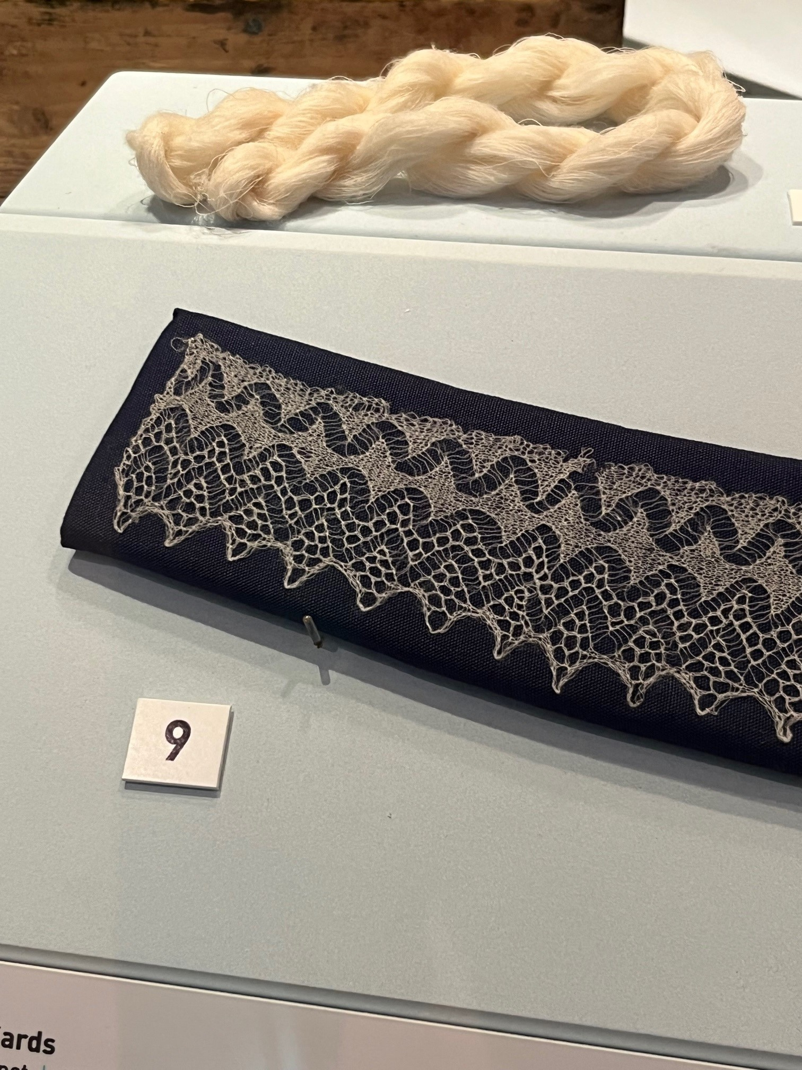
Write it
Start writing early.
Write as you go.
Research Projects Handbook
Don’t forget to have time for editing.
TPM305A Writing a Master’s Thesis in English (elective)
Notes:
If the research is spinning the yarn, the writing is knitting it all together into a coherent whole.

Slide 17
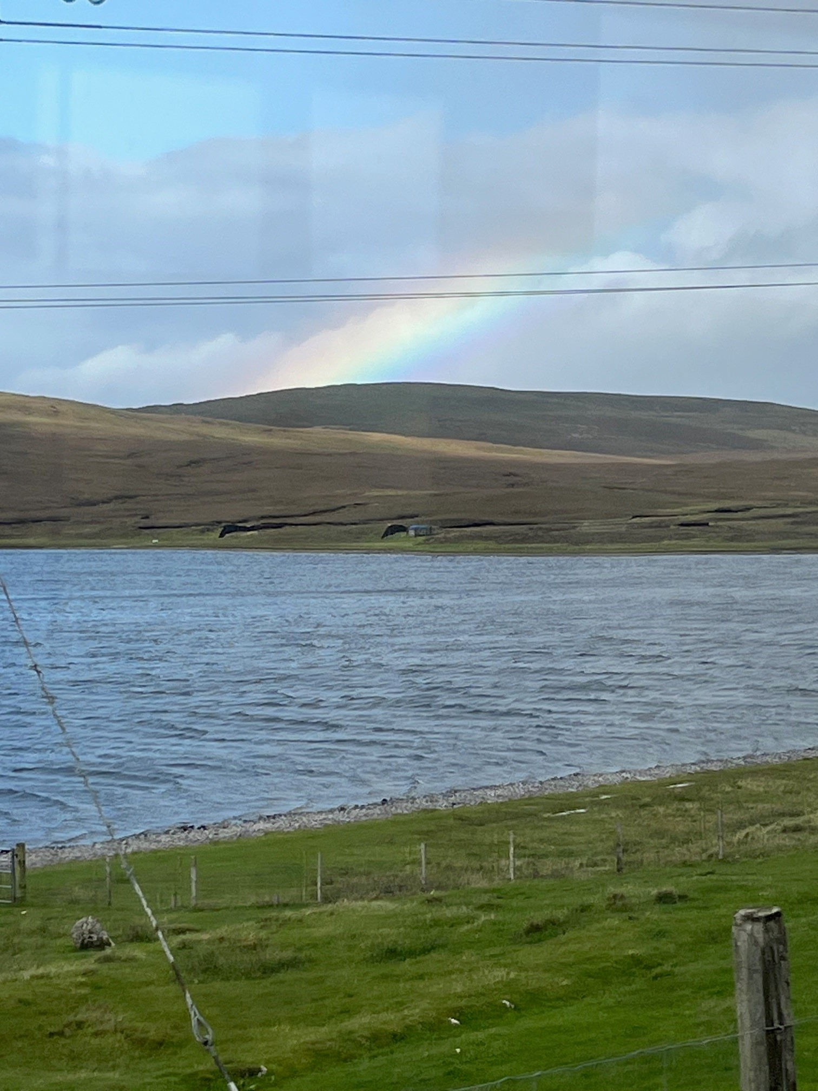
Thesis Defense
Presentation—20-30 min open to public.
Defence—30-45 min closed session oral exam
Grading Scheme is available on Thesis Brightspace
See study guide for committee requirements

Slide 18
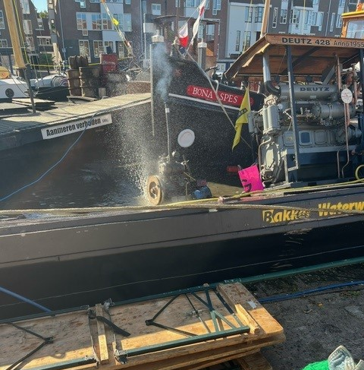
Things will go wrong
Every MEP student experiences challenges and ups & downs. That’s OK! Things will not go as planned.
Ask for help: supervisor, academic counsellor

Slide 19
Resources
Brightspace Thesis Office Applied Sciences —references and guidelines
TU Delft Writing Centre
Supervisor
Academic Counsellor
Notes:
If you run into problems, please let us know. It’s really sad to hear about problems in the thesis evaluation that maybe we could have fixed earlier.

Slide 20
Questions?

Slide 21
Article 25 Composition of the assessment committee for MSc thesis projects
…The committee will consist of at least three members. At least two members belong to academic staff (tenured or tenure track) not limited to TU Delft, Erasmus MC, nor Leiden University or members for the occasion appointed by the Board of Examiners (art 5.2)^{[1]}. The third member can be a member of academic staff or a researcher with a PhD employed at TU Delft (or Erasmus MC, for Nanobiology). Together they satisfy the criteria a to d. Committee members that do not meet the criteria, including PhD students, can be added as fourth or fifth member of the committee.
a. One of the members of academic staff is the responsible thesis supervisor, chosen according to the Programme specific appendix to the MSc Teaching and Examination Regulations. In case of two supervisors both are member;
b. One of the members belongs to the teaching staff of the MSc programme, according to art 5.1.a^{[2]}, and is familiar with the final attainment levels of the programme;
c. One of the members is a full professor or an associate professor with ius promovendi;
d. One of the members of academic staff belongs to a TU Delft^{[3]} research group or research entity independent^{[4]} of the responsible thesis supervisor.
If the composition of the assessment committee does not meet the regulations mentioned, the proposal must be submitted to Board of Examiners.
Note: The Board of Examiners has decided that in practice one of the members belongs to the teaching staff of the MSc or the BSc programme, and is familiar with the final attainment levels of the programme

