Slide 1


MEP/MEP event
28 November, 2023
Information about the MEP

Slide 2
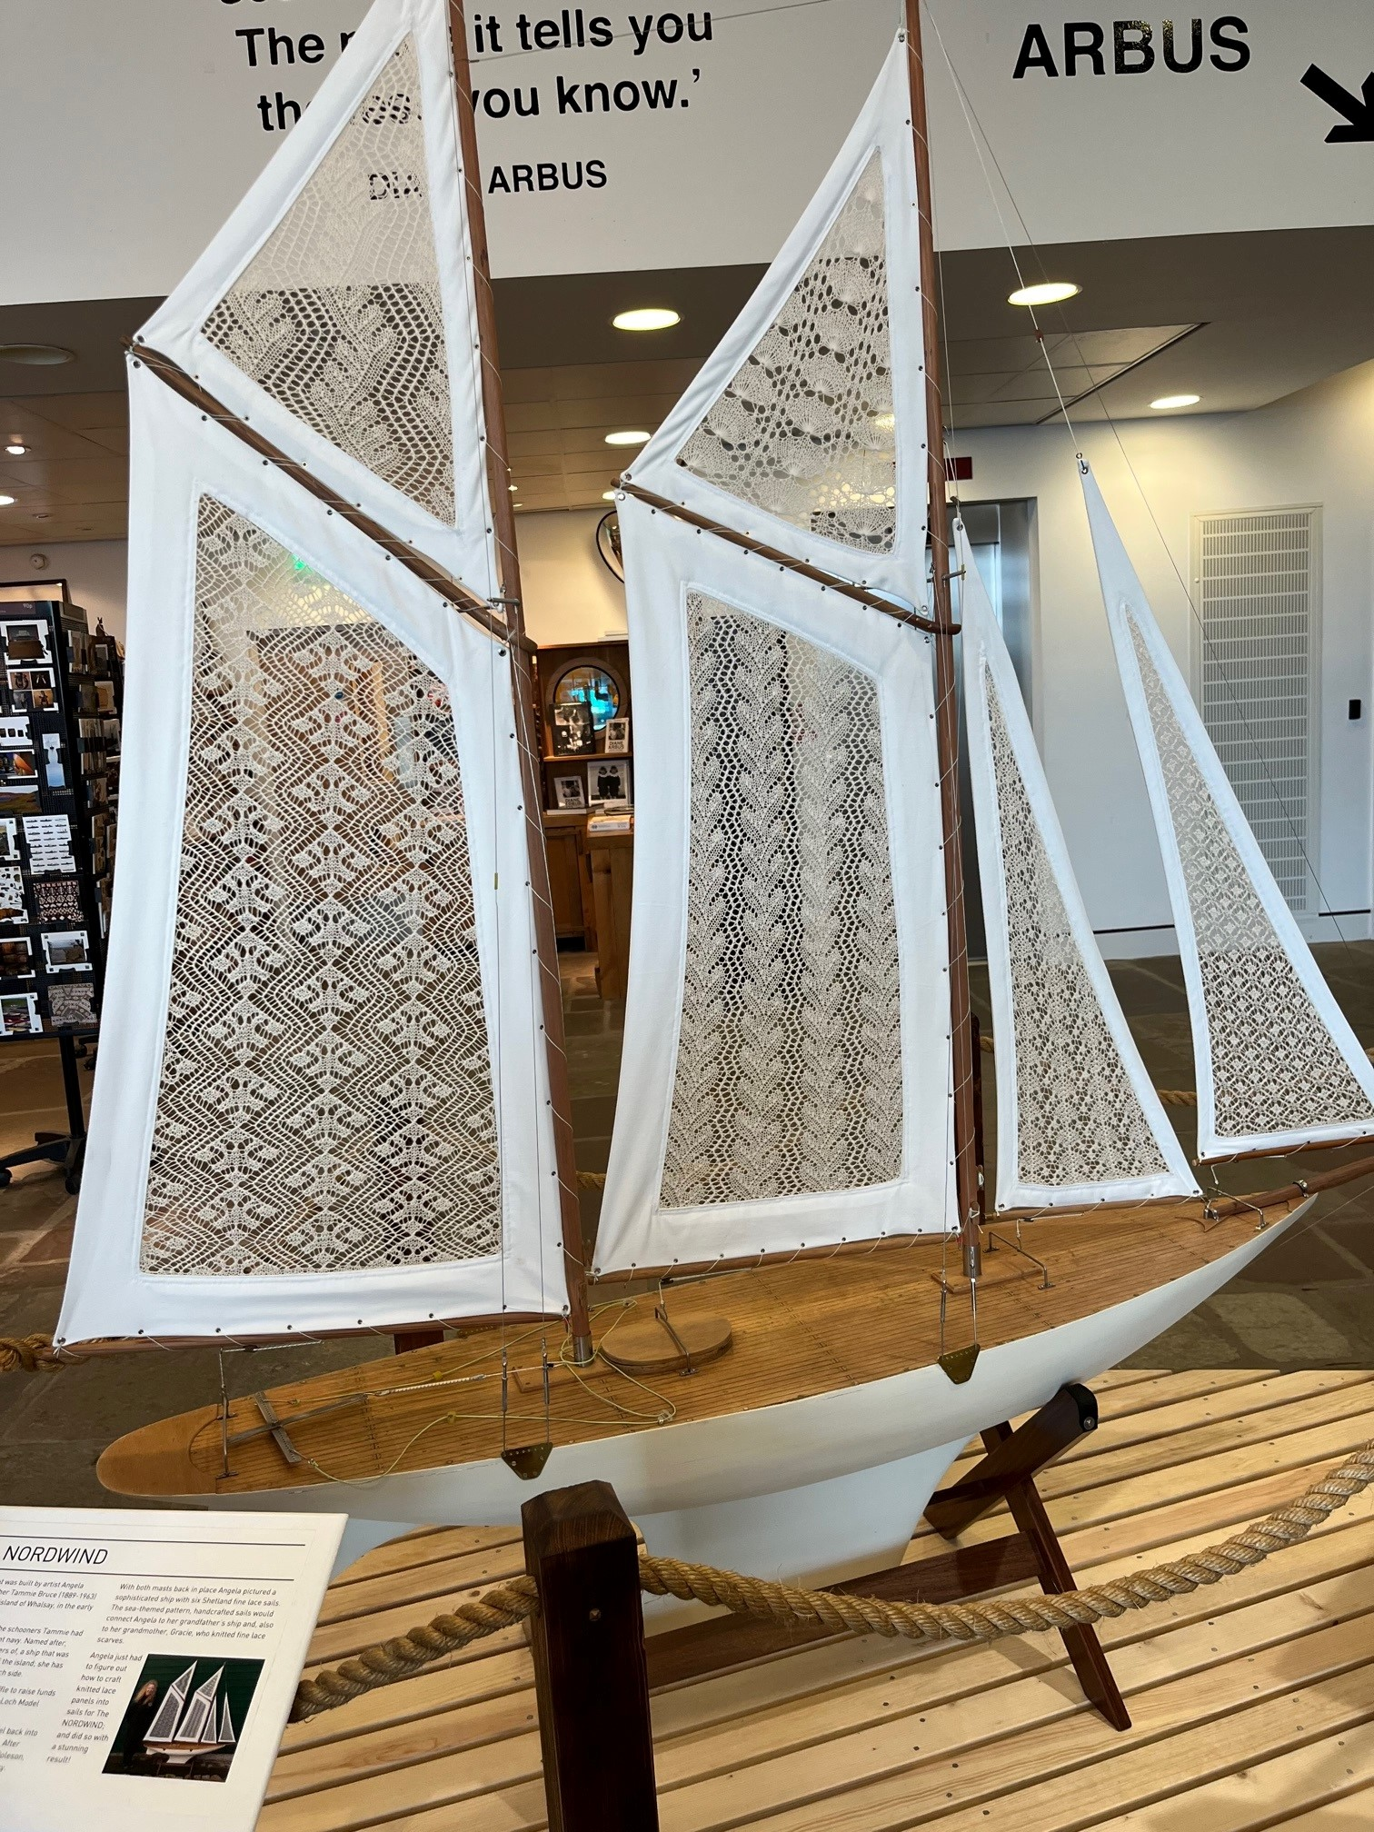
What is a Master’s End Project (MEP)?
What is it?
How long is it?
What does it include?
Notes:
Individual research project (42 ECT) in research group at TU Delft, Erasmus MC or comparable research lab elsewhere
Takes approx. 8 months (slightly less than 3 quarters)
Includes writing a thesis, presentation and defence
See also the study guide

Slide 3
Steps of a MEP
Enrol in Brightspace Thesis End Project
Find a supervisor and project
Do the Project Development Courses
Get it approved
Do the research
Write the report
Defend it

Slide 4

Enrol in Brightspace
Step by Step guide
MEP Application forms
GreenList
Writing Guidelines
Grading Scheme

Slide 5
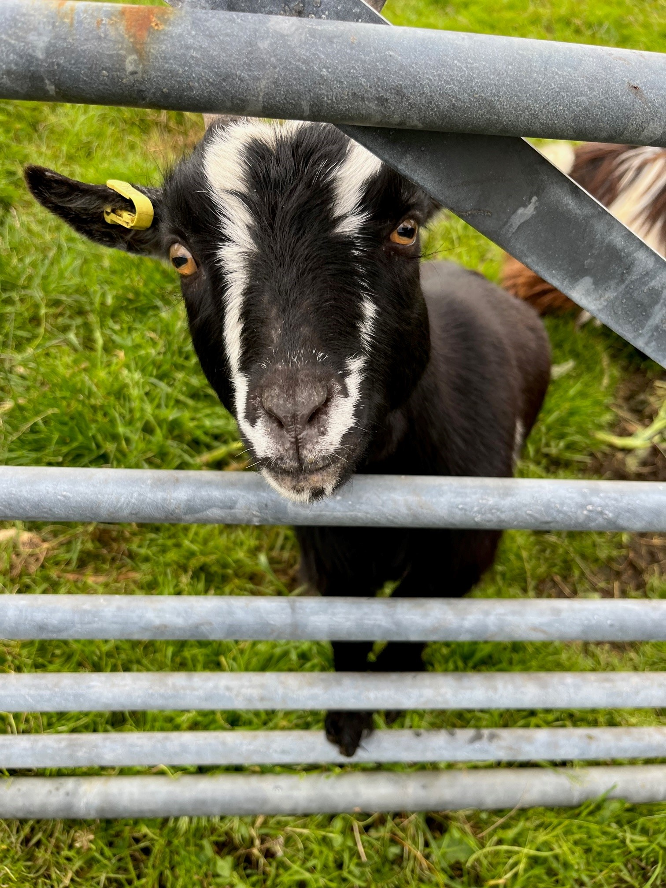
How do you find a supervisor?
GreenList
Seminars
Read articles
Network
BEP/MEP Booklet
Notes:
Come up with a broad plan: research field, type of project, type of supervision, start & duration
Use the GreenList to identify potential supervisors
Attend seminars and talks by interesting supervisors
Read articles from research groups you think are interesting
Ask friends, teachers, mentors, BEP supervisor for input
Look in the BEP/MEP Booklet
Go to the MEP event (you’re here)

Slide 6
Meeting with Potential Supervisors
Talk to multiple interesting research supervisors:
Bring your study plan
Ask all your questions
Indicate clearly what you want
Notes:
Consider how hard it was to arrange a time to meet with them.

Slide 7
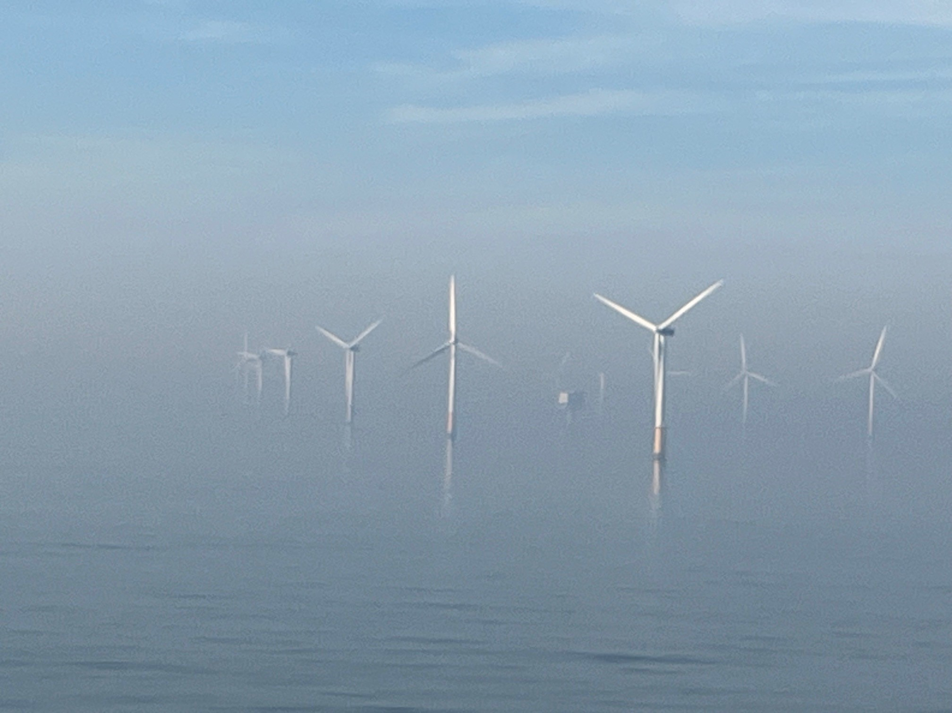
Considerations
You should ask about:
Research group work environment
Communication with supervisor
Average time to completion
Outcomes—where do graduates of the lab go
Notes:
You want a research group that works well together, is supportive of each other, and has a level of social engagement that you’re comfortable with. Is all work done in the lab, will you have a spot to work?
You want a supervisor who is eager to communicate with you and who doesn’t intimidate you.
Some supervisors are super strict about getting things done on time, some are more flexible, consider what works well for you.
Especially if you want to go into a PhD programme, seeing where students from the lab have ended up can give a good indication of what will be supported for you.

Slide 8
Supervision
Must be a supervisor from the green list: this person is officially responsible for your MEP and the assessment.
Guidance on your MEP is almost always done by daily supervisor: mostly PhD student or Postdoc.
Picking a supervisor who is a good match for you may be the most important part of your MEP.
Research group environment

Slide 9
Requirements for Starting
Completed 35 ECTS from the NB MSc
Passed any remaining bridging/homologation courses
Have a study plan for remainder of courses
Completed Project Development Courses (NB4510 and NB4520)
Completed your MEP application form
MEP may not be in the same lab you did an academic research project in.

Slide 10
Starting a MEP
Fill out the MEP application form before starting your project.
Have your supervisor sign it.
Send the form to info-msc-nb@tudelft.nl for final signature.
Email it to the Thesis office.
MEP at Erasmus MC requires special forms for stage. Instructions on NB MSc Brightspace

Slide 11
Before you start
Make sure your supervisor(s) is someone you can talk to—you’ll need to talk a lot.
Have agreement on work environment—lab space, resources, participation in research group activities
Have clear communication channels and expectations between you and daily supervisor and responsible supervisor—when, where, how
Make a plan—your plan, deadlines and structures you need. Change it as needed. Have agreement on plan with supervisor.

Slide 12
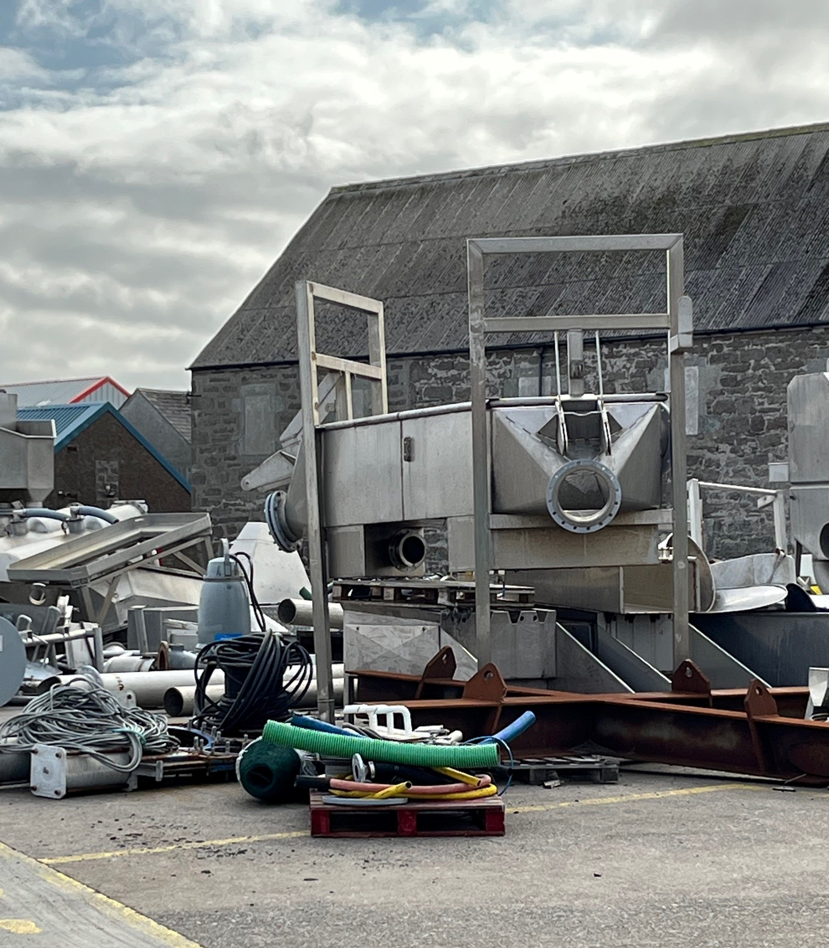
Work on it
Typically it takes 7-8 months.
You can do it part time or full time depending on other coursework.
Have a plan with your supervisor.
Ask us when you have questions or problems.

Slide 13
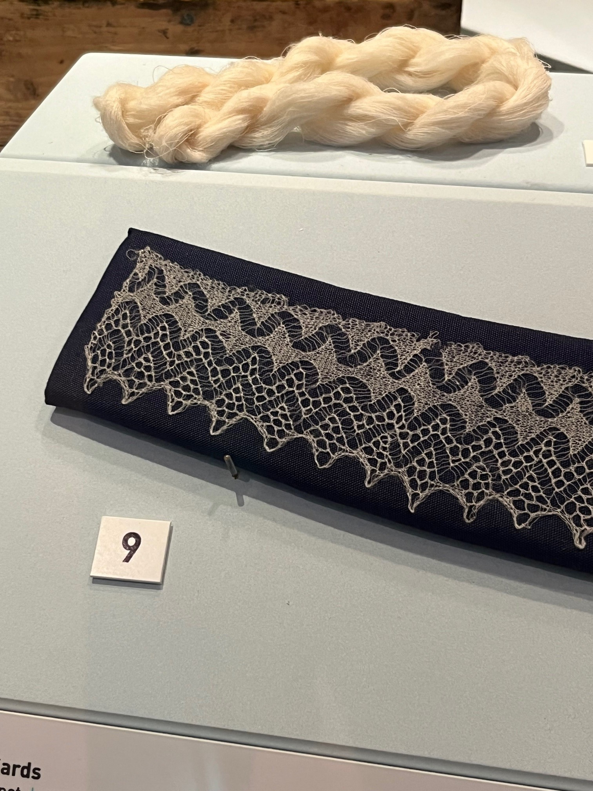
Write it
Start writing early.
Write as you go.
Thesis Brightspace has writing resources.
Don’t forget to have time for editing.
TPM305A Writing a Master’s Thesis in English (elective)
Notes:
If the research is spinning the yarn, the writing is knitting it all together into a coherent whole.

Slide 14
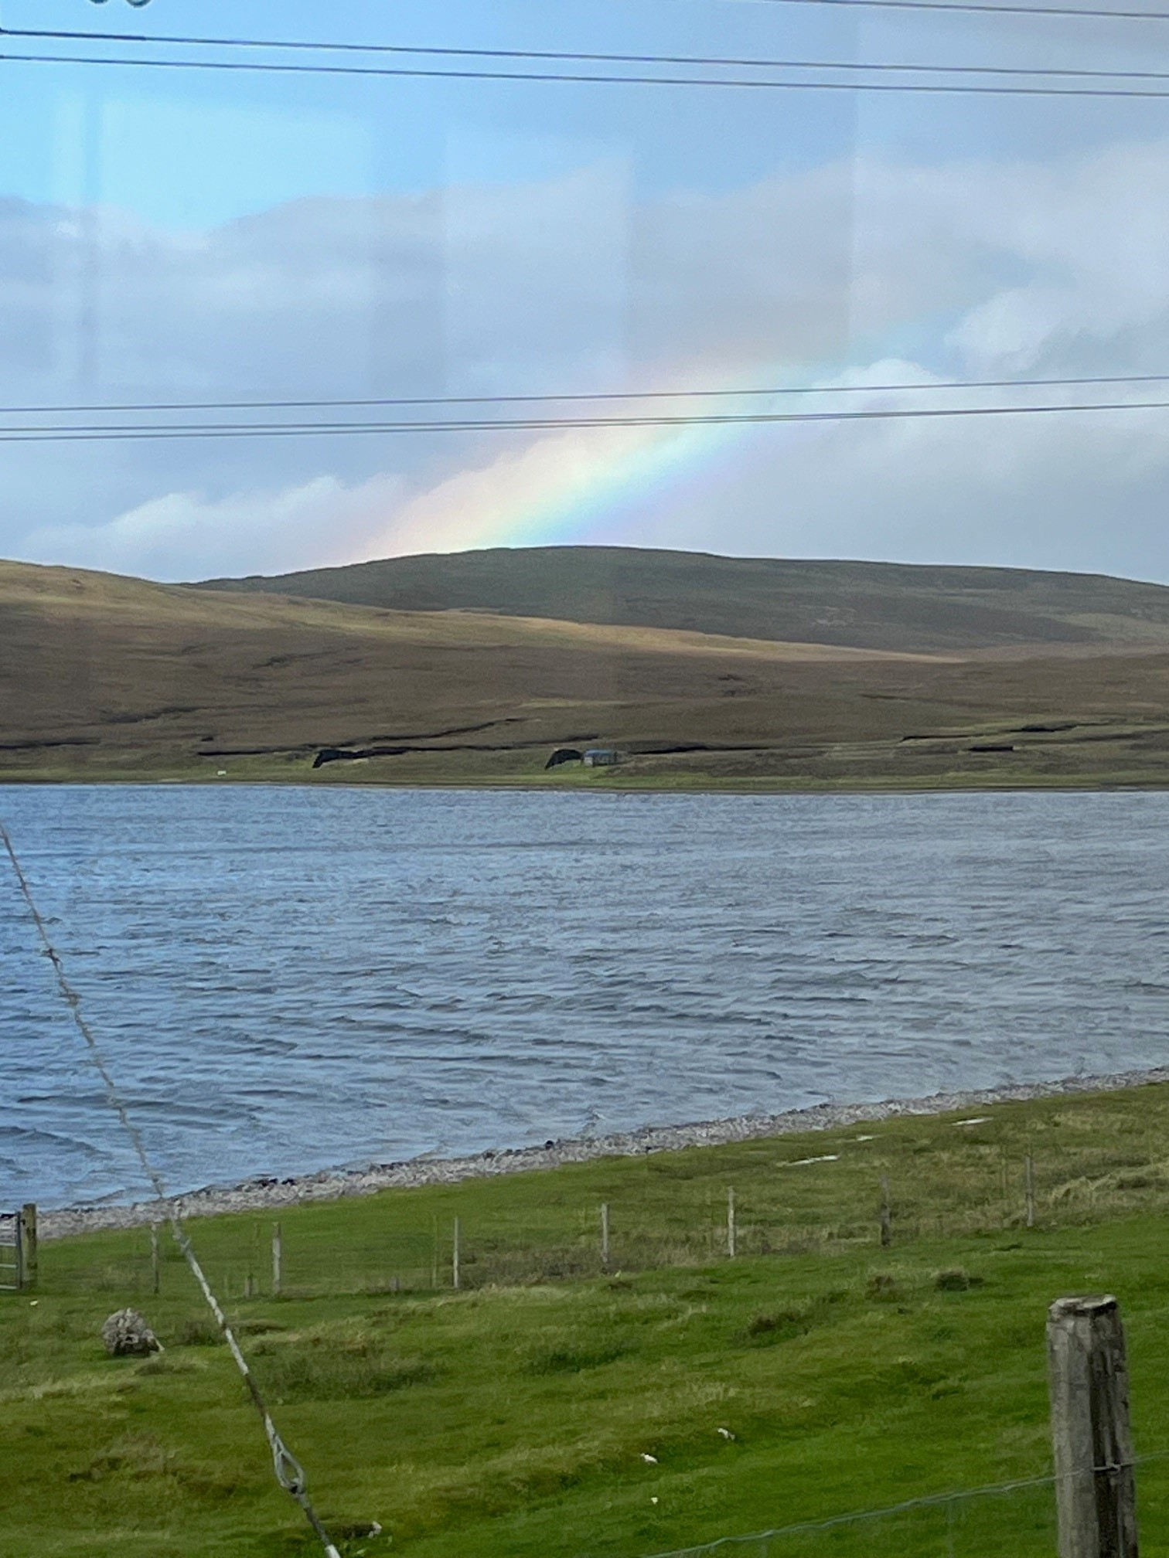
Thesis Defense
Send your full committee to Thesis office 1 month before
Presentation—20-30 min open to public.
Defence—30-45 min closed session oral exam
Grading Scheme is available on Thesis Brightspace
See study guide for committee requirements

Slide 15
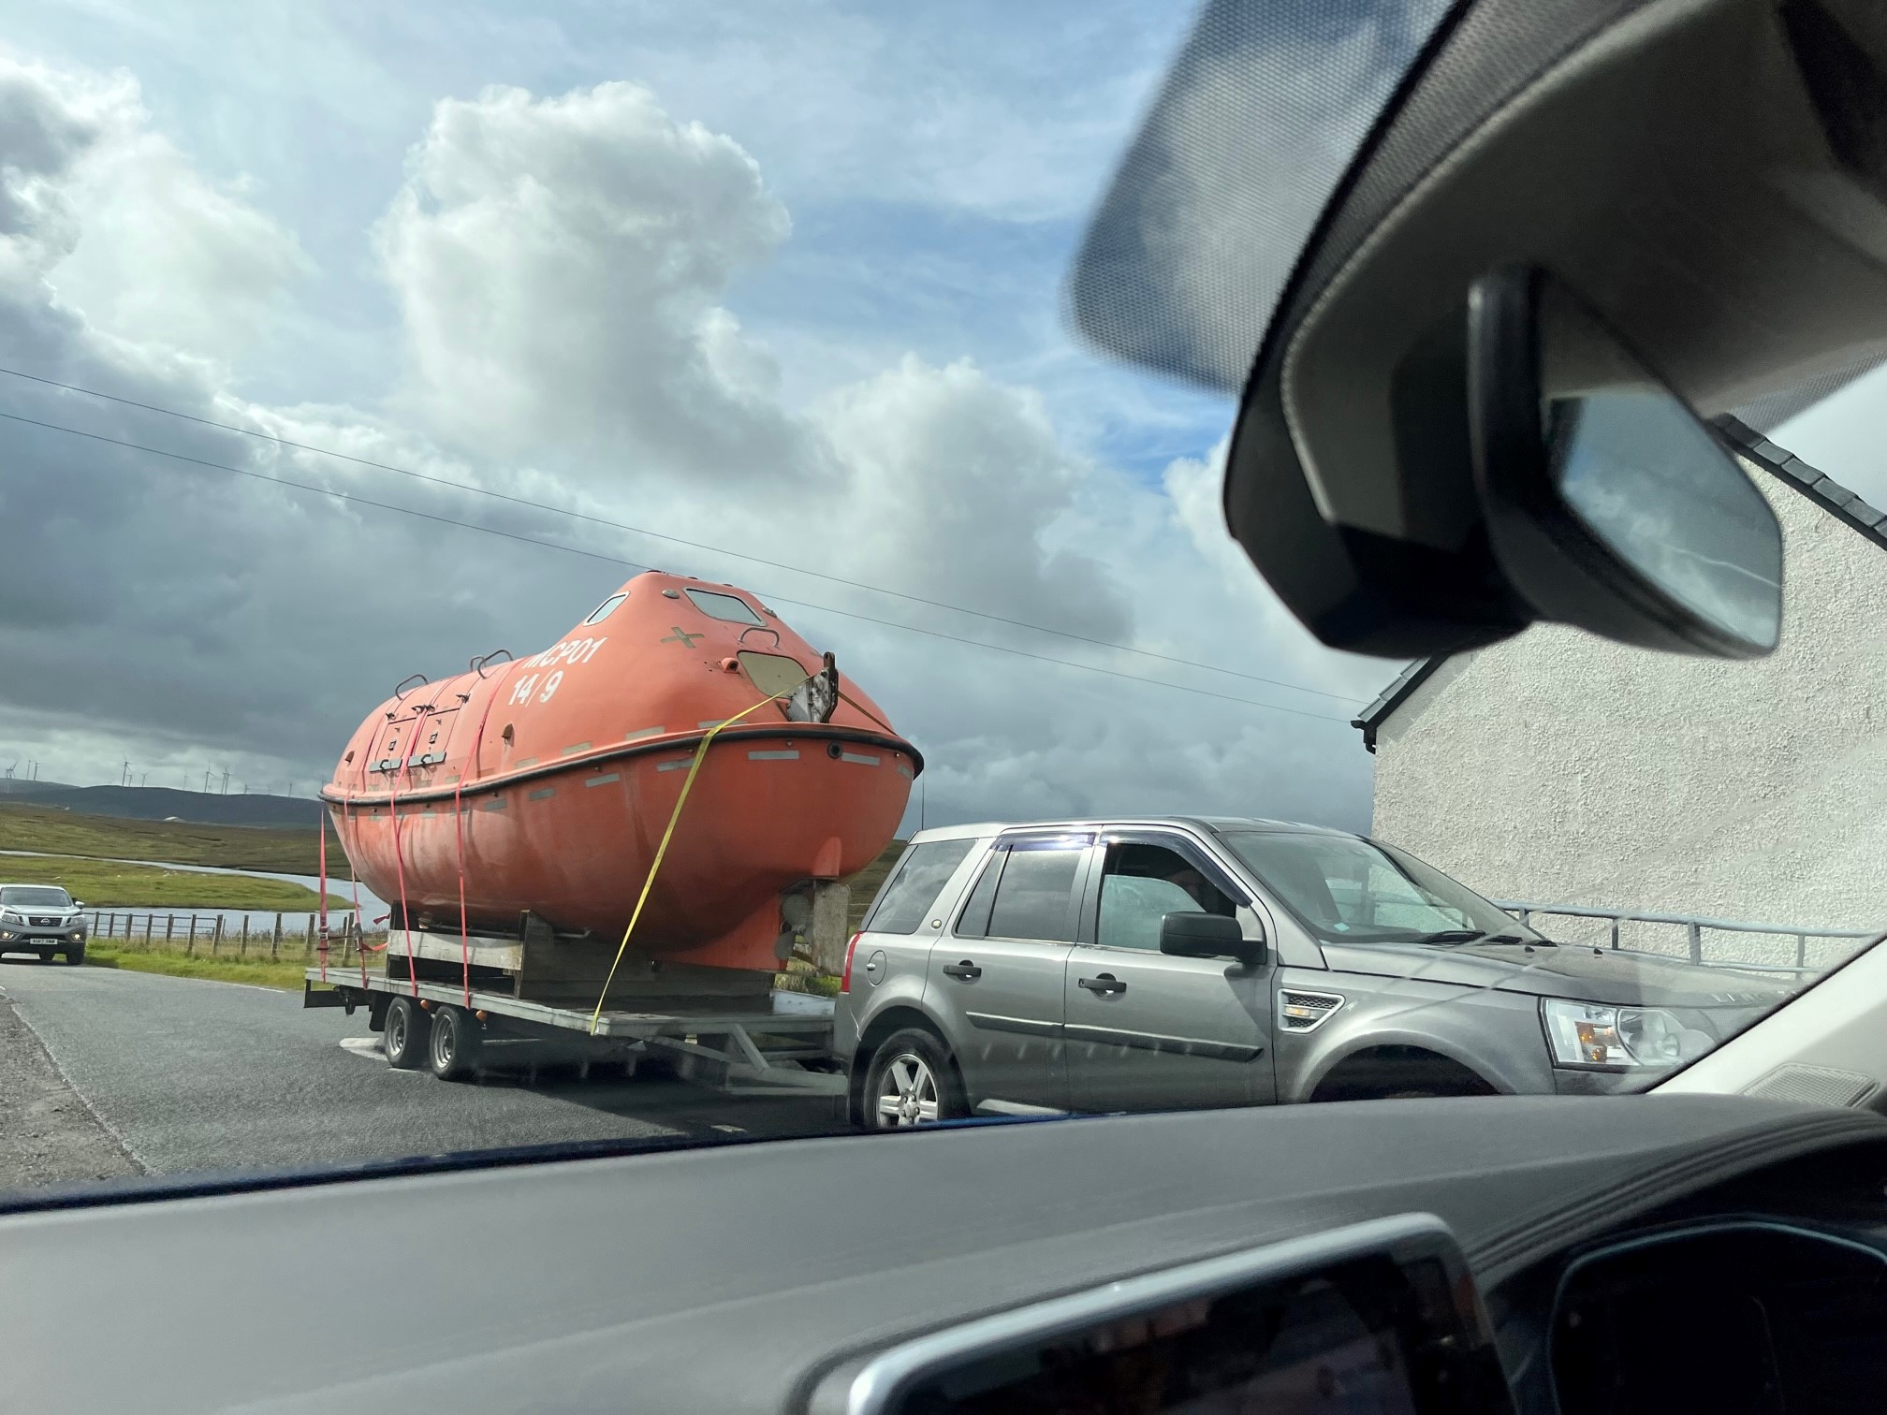
Things will go wrong
Every MEP student experiences challenges and ups & downs. That’s OK! Things will not go as planned.
Ask for help: supervisor, academic counsellor

Slide 16
Resources
Thesis Brightspace Page—references and guidelines
TU Delft Writing Centre
Supervisor
Academic Counsellor
Notes:
If you run into problems, please let us know. It’s really sad to hear about problems in the thesis evaluation that maybe we could have fixed earlier.

Slide 17
Questions?

Slide 18
Supporting Courses
NB5015 Seminars—self paced, can finish while doing your MEP
Project development courses are now taken BEFORE you start

Slide 19
Article 25 Composition of the assessment committee for MSc thesis projects
…The committee will consist of at least three members. At least two members belong to academic staff (tenured or tenure track) not limited to TU Delft, Erasmus MC, nor Leiden University or members for the occasion appointed by the Board of Examiners (art 5.2)^{[1]}. The third member can be a member of academic staff or a researcher with a PhD employed at TU Delft (or Erasmus MC, for Nanobiology). Together they satisfy the criteria a to d. Committee members that do not meet the criteria, including PhD students, can be added as fourth or fifth member of the committee.
a. One of the members of academic staff is the responsible thesis supervisor, chosen according to the Programme specific appendix to the MSc Teaching and Examination Regulations. In case of two supervisors both are member;
b. One of the members belongs to the teaching staff of the MSc programme, according to art 5.1.a^{[2]}, and is familiar with the final attainment levels of the programme;
c. One of the members is a full professor or an associate professor with ius promovendi;
d. One of the members of academic staff belongs to a TU Delft^{[3]} research group or research entity independent^{[4]} of the responsible thesis supervisor.
If the composition of the assessment committee does not meet the regulations mentioned, the proposal must be submitted to Board of Examiners.
Note: The Board of Examiners has decided that in practice one of the members belongs to the teaching staff of the MSc or the BSc programme, and is familiar with the final attainment levels of the programme

