Slide 1


BEP/MEP event
November 26, 2024
Information about the BEP

Slide 2
What is a Bachelor’s End Project (BEP)?
Individual research project (20 ECT) in research group at TU Delft or Erasmus MC
Theoretical or experimental
Elements: literature study, research work, thesis, presentation and defence
Participating in research group: lab meetings
See also the study guide

Slide 3
Requirements for Starting
Completed entire 1st year
60 ECTS from 2nd/3rd year (incl. minor)
Have a GreenList supervisor

Slide 4
Steps of a BEP
Enrol in Brightspace Thesis End Project
Find a Supervisor and Project
Get it approved
Make a plan
Do the research
Write the thesis
Defend it

Slide 5
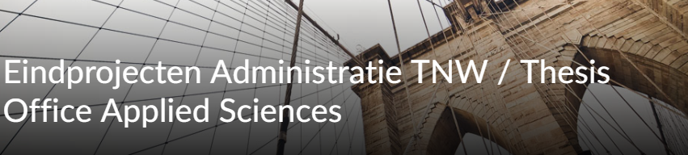
Enrol in Brightspace
Step by Step guide
BEP Application forms
Green List
Writing Guidelines
Grading Scheme

Slide 6
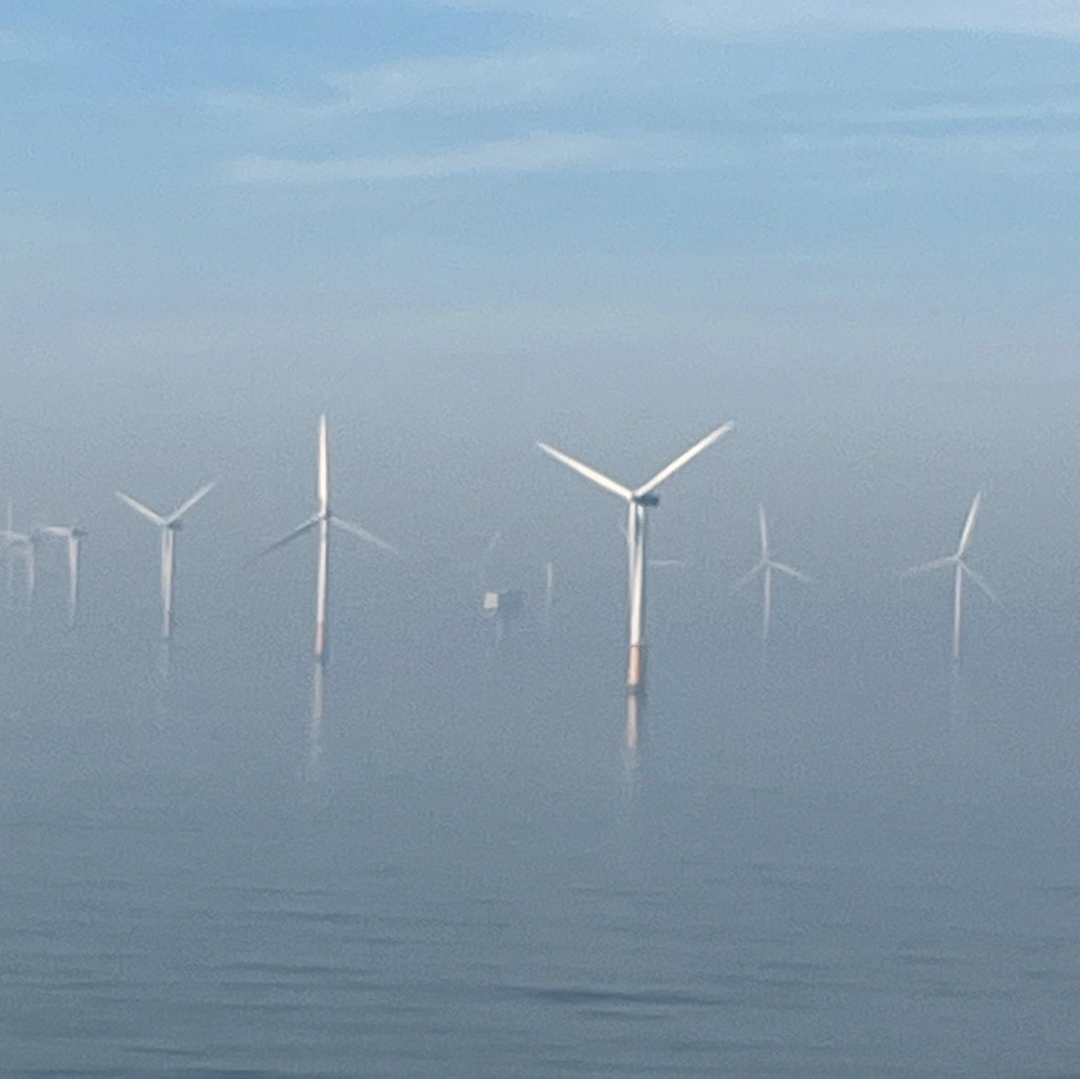
Finding a BEP—1
Start with a broad plan
  research field
  type of BEP—lab, computational
  timeline
  desired environment

Slide 7
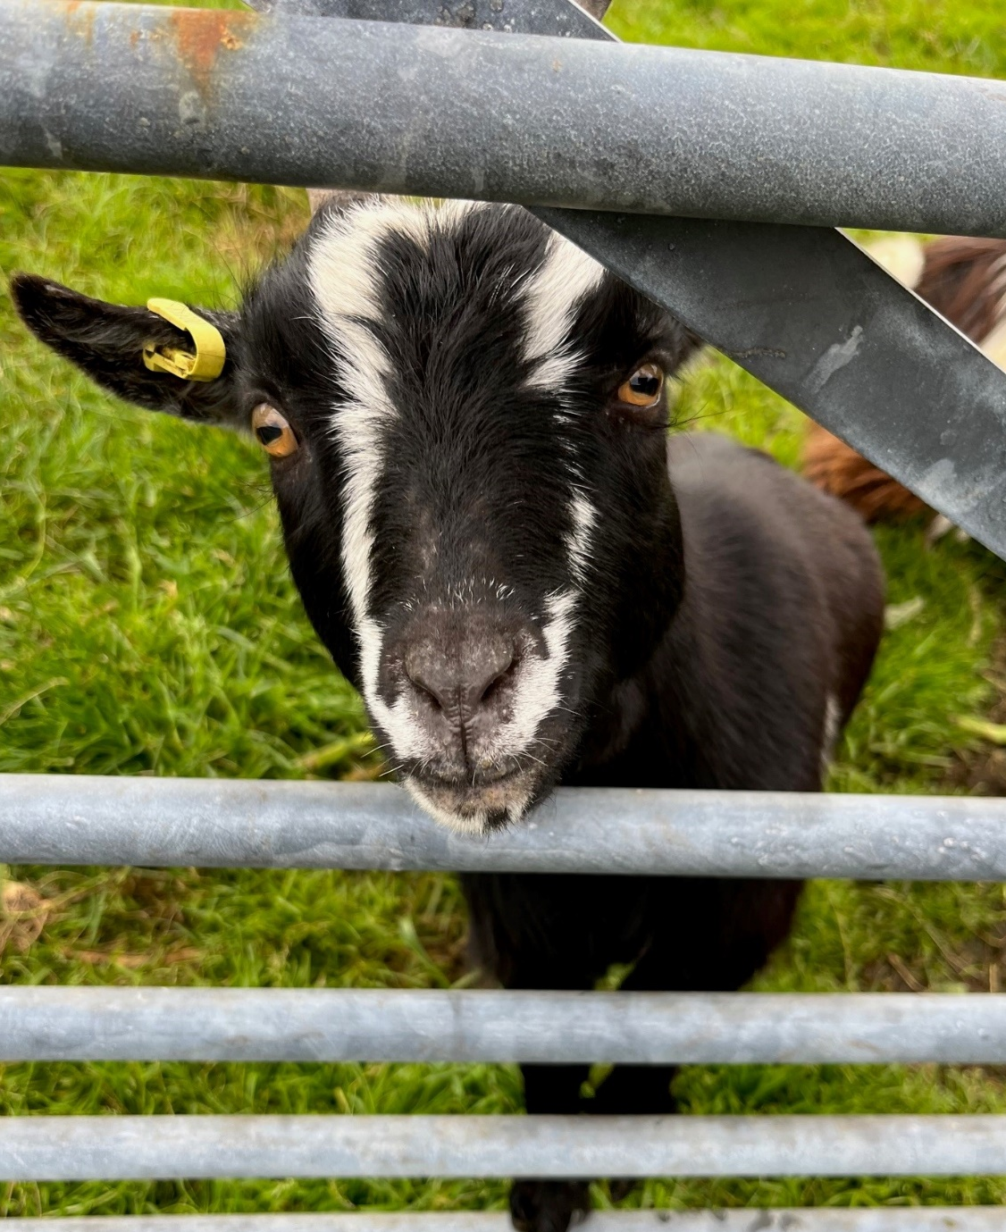
Find a Supervisor
Identify options
  GreenList
  Teachers
  Seminars
  Hooke handbook
  Fellow students
  Websites

Slide 8
Meet with Potential Supervisors
Talk to more than one:
  Bring your study plan
  Ask a lot of questions
  Indicate clearly your needs
  Consider your options, focus not only on content BEP
  Pick a supervisor who you can talk to

Slide 9
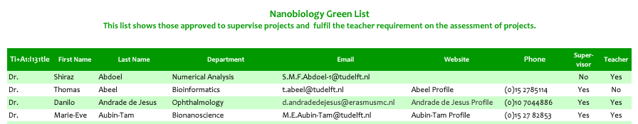
Supervisor
Must be supervisor on the GreenList: this person is officially responsible for your BEP and the assessment.
Most projects have a PhD or Post-doc who serves as a daily supervisor.

Slide 10
Necessary Forms for a BEP
Fill out the BEP application form. (Thesis Brightspace page)
Send the form to info-bsc-nb@tudelft.nl for final signature before starting your project.
BEP at Erasmus MC requires special forms for access. Instructions on NB BSc Brightspace—must be submitted at least 30 days prior to start!

Slide 11
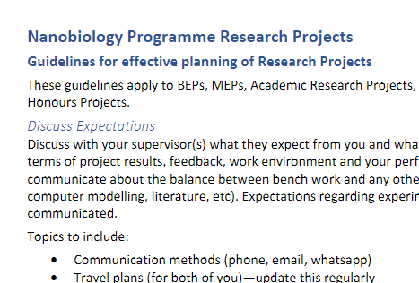
Make a Plan
Read End Project Planning Guides on Thesis Brightspace
Make a plan—see guidelines

Slide 12
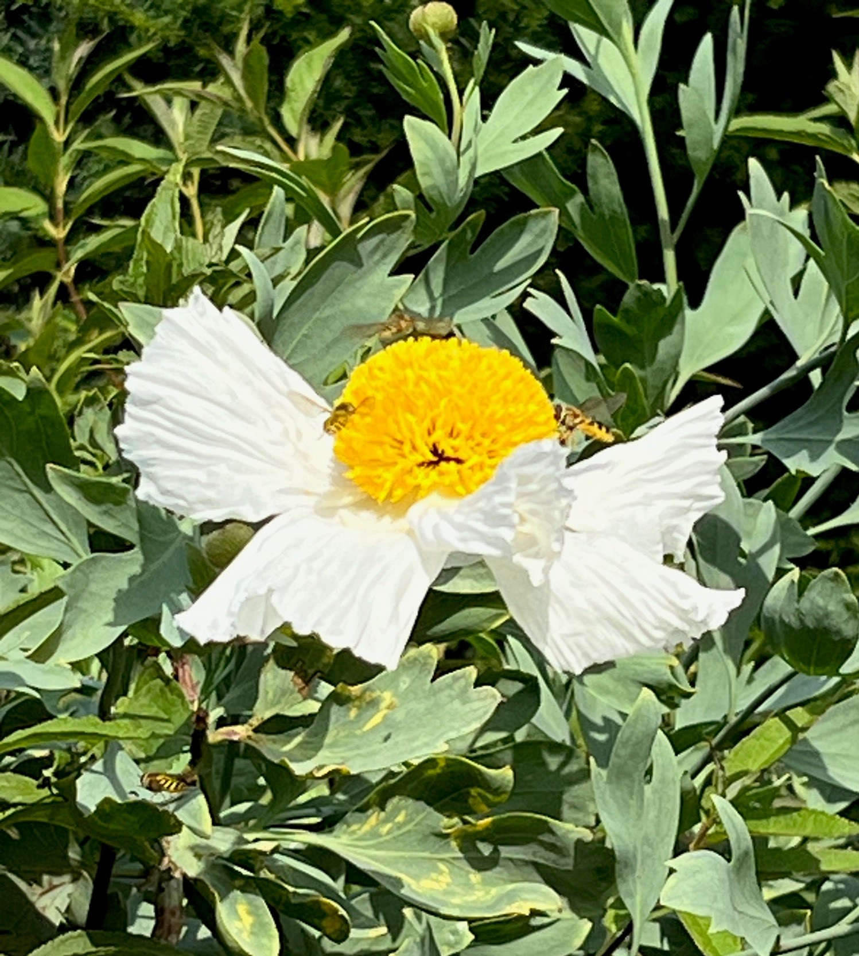
Work on it
Typically, 3 months
Part time or full time
Change plan as needed
Ask us if you have questions or problems

Slide 13
Write it
Start writing early
  Writing a Thesis in English course in Q4
Write as you go
Thesis Brightspace has writing resources
Don’t forget to make time for editing

Slide 14
Thesis Defence
Need your 2nd Examiner
  Both must be on greenlist, one a teacher in Nanobiology
Presentation—20-30 min open to public
Defence—30-45 min closed session oral exam
Grading Scheme is available on Thesis Brightspace

Slide 15
To keep in mind
Every BEP student experiences challenges and ups & downs. That’s OK! Things will not go as planned.
The goal is to learn the process of doing a research project, world changing results are not necessary.
This is your project—your timeline, your structure.
Ask for help: supervisor, academic counsellor.

Slide 16
Resources
Thesis Brightspace Page—references and guidelines
TU Delft Writing Centre
Supervisor
Study Advisor

